Slide 1

Ready Your RasPi
Yao-Tung Tsou

Slide 2
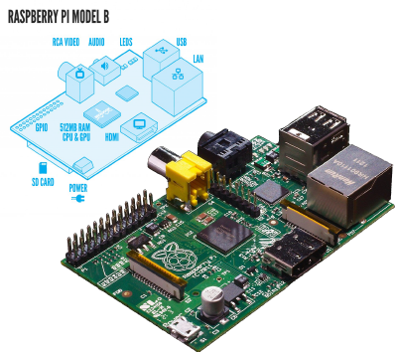
What is a raspberry pi?
The Raspberry Pi is a credit-card sized computer which can be used for many of the things that your desktop PC does, like word-processing and games.
However one key aspect that makes the Raspberry Pi so brilliant for schools is its ability to execute “Python” coded programs. This allows us along with the General Purpose Input Output (GPIO) pins to create programs that can control anything from a single LED to opening your garage door.

Slide 3
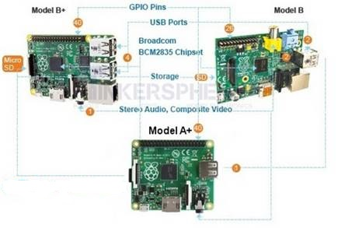
Comparing the Model A+ vs Model 2/B+ and Model B

Slide 4
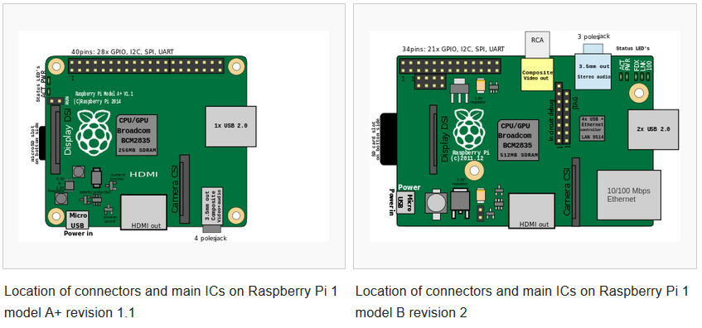
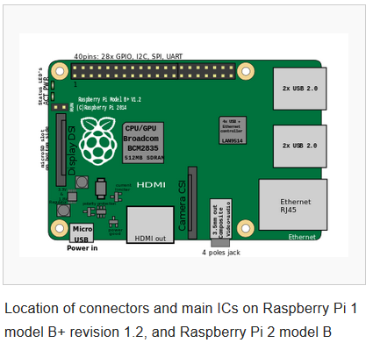
Connectors

Slide 5
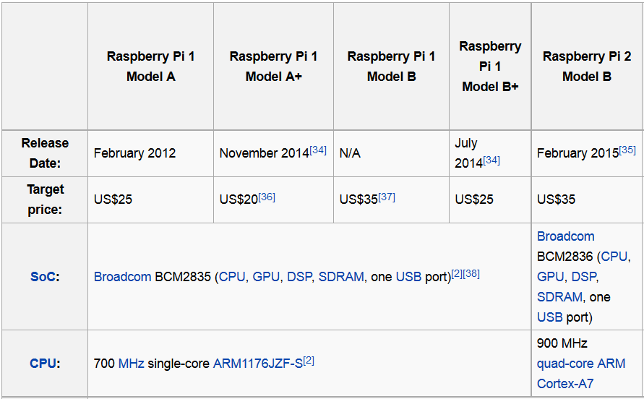
The Details to Each Pi

Slide 6
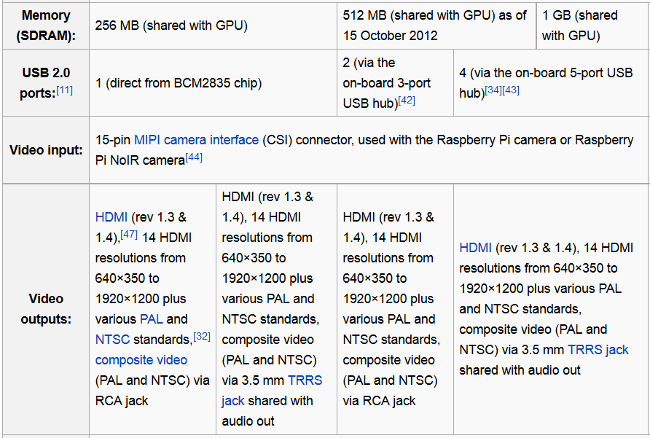
The Details to Each Pi

Slide 7
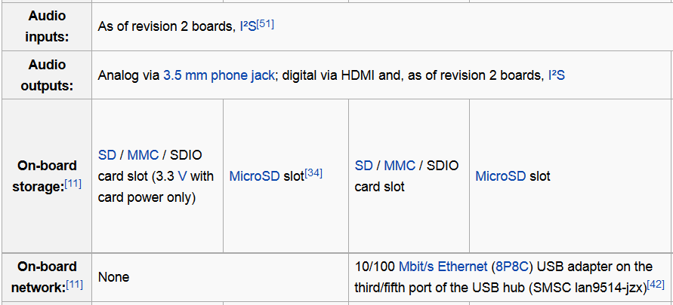
The Details to Each Pi

Slide 8
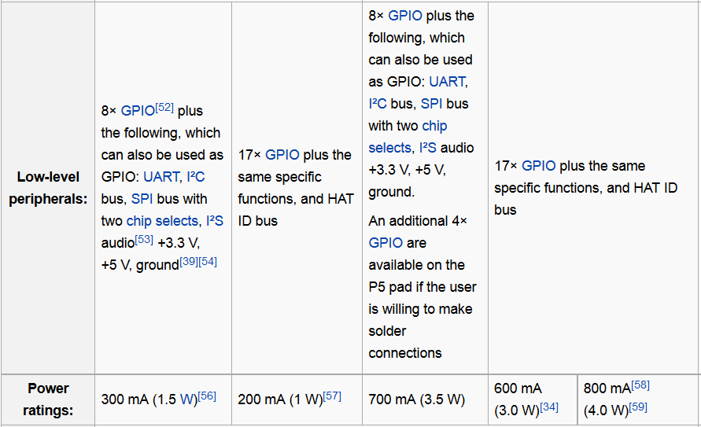
The Details to Each Pi

Slide 9
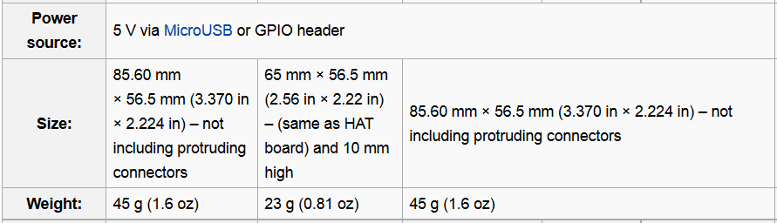
The Details to Each Pi

Slide 10
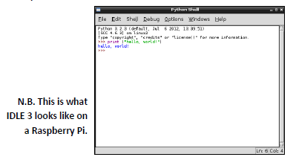
What is Python?
Python is a free to use programming language that runs on Windows, Linux/Unix, Mac OS X and has even been ported to Java and .NET virtual machines.
IDLE is a special text editor software — like Microsoft Word — however it understands the language Python. This enables us to write in a language that our Raspberry Pi will be able to understand and interpret.
Notes:
It is a GUI toolkit.
IDLE (Integrated DeveLopment Environment) is an integrated development environment for Python, which has been bundled with the default implementation of the language since 1.5.2b1.

Slide 11
Start to Set up Your Environment

Slide 12
We Need
Raspberry Pi x1
SD Card x1
Keyboard & mouse x1
HDMI、USB wire x1

Slide 13
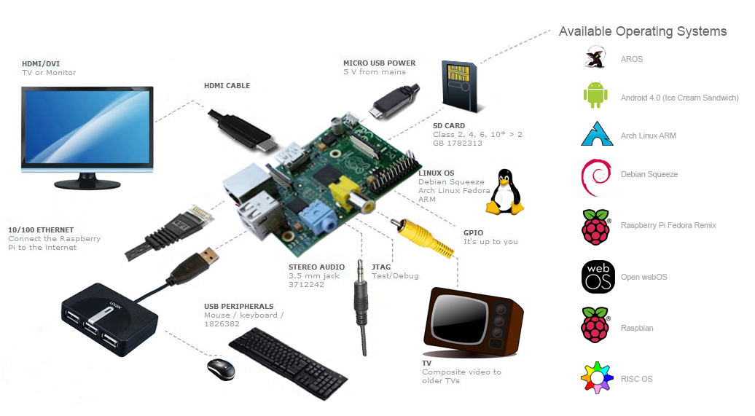
Installing “NOOBS”
To get started with Raspberry Pi you need an operating system. NOOBS (New Out Of the Box Software) is an easy operating system install manager for the Raspberry Pi.:
1. Download NOOBS
2. [option] Format your SD card before copying the NOOBS files onto it
3. Move NOOBS (unzip format) to SD card
4. Inset SD card to raspberry pi and reboot
NOOBS (http://www.raspberrypi.org/downloads)
SD card format (https://www.sdcard.org/downloads/formatter_4/)

Slide 14
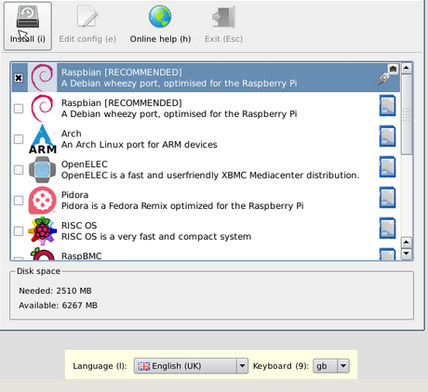
Boot your Pi
Waiting for a while, you will see NOOBS menu.
Select Raspbian
Language: US
Keyboard: US
Install

Slide 15
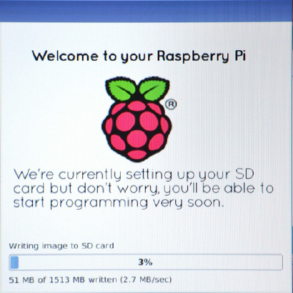
Boot your Pi

Slide 16
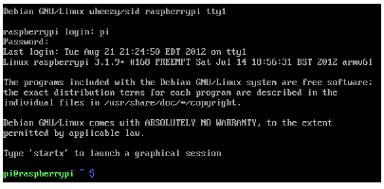
Logging In
Now it is time to turn on our Raspberry Pi. When the memory card, HDMI lead, Ethernet cable, mouse and keyboard are plugged in, plug in the power lead.
As soon as you do this. You screen should be black and filled with white text. This will be visible every time you turn on your raspberry pi.
Wait until your screen reads “raspberrypi login:”
Username = pi [ENTER]
Password = raspberry [ENTER]

Slide 17
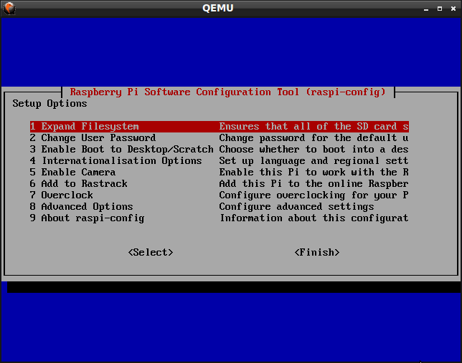
Configuring Raspberry Pi
Expand the partitions in your hard drive. This allows us to use all of the available space in the memory card.
Type the line: “sudo raspi-config”
Select “1. Expend Filesystem“
Press the enter button
Finish and go to user interface: startx

Slide 18
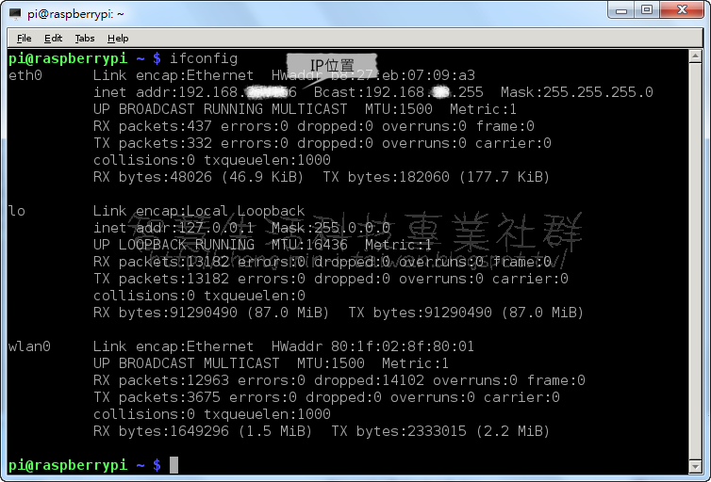
Setting static IP network [option]
Plug in your Ethernet RJ45 port
In your terminal, typing: ifconfig, to see and record your ip address

Slide 19
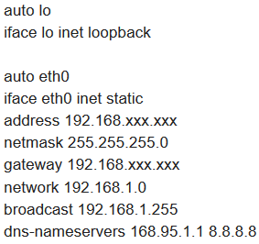

Setting static IP network
Get default gateway: ip route show
sudo nano /etc/network/interfaces
Save:
Ctrl+O, Enter
Leave:
Ctrl+X
Reboot:
sudo reboot

Slide 20
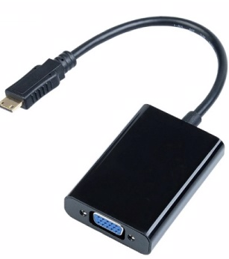
Originally, you need to use HDMI adapter to display a control window.
It is not convenient.
What’s the solution?

Slide 21
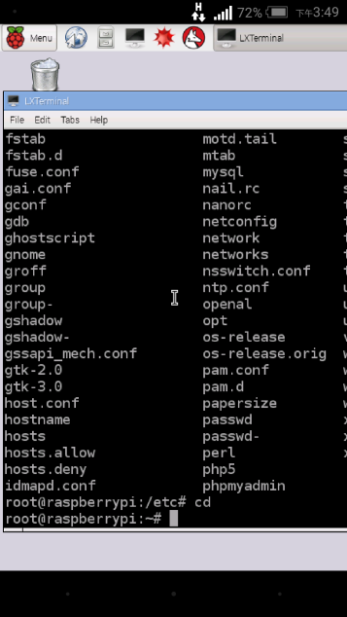



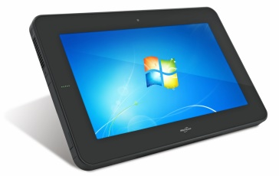
VNC
Remotely connect to Raspberry Pi via PC, Notebook, Tablet, or Smart Phone

Slide 22
Setting VNC Server on RasPi
Step 1. update and upgrade RasPi program.
sudo apt-get update
sudo apt-get upgrade
Step 2. install tightvncserver
sudo apt-get install tightvncserver

Slide 23
Setting VNC Server on RasPi
Next, run TightVNC Server which will prompt you to enter a password and an optional view-only password:
tightvncserver
Start a VNC server from the terminal. This example starts a session on VNC display one (:1) with full HD resolution:
vncserver :1 -geometry 1920x1080 -depth 24

Slide 24
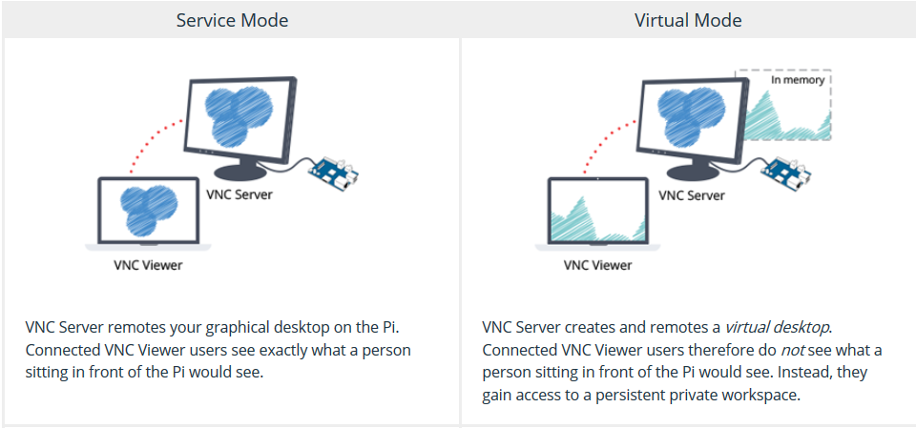
Getting connected

Slide 25
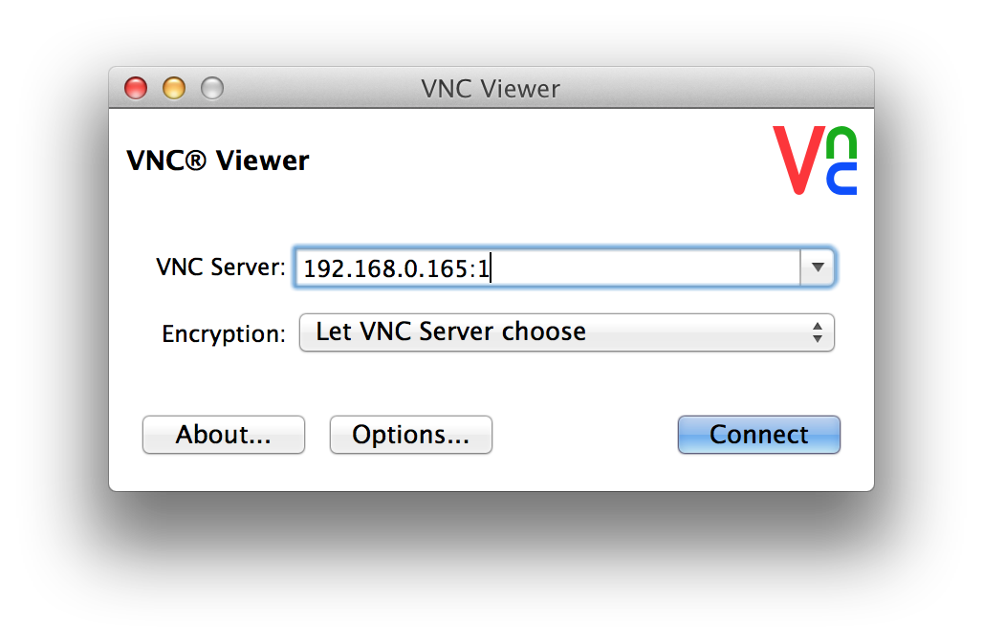
Setting VNC Client on your Side
Step 1. download VNC Viewer
http://www.realvnc.com/download
step 2. connect

Slide 26
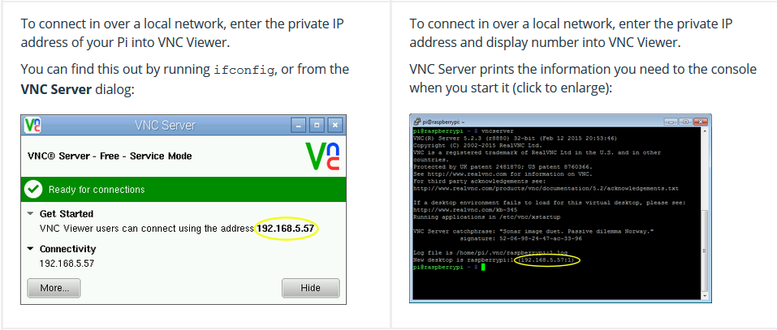

What’s the mode you are in?

Slide 27
Another remote connection?
SSH

Slide 28
Secure Shell (SSH)
You can use SSH to connect to your Raspberry Pi from a Linux computer or Mac (or from another Raspberry Pi) from the terminal, without installing additional software.
You'll need to know your Pi's IP address to connect to it. To find this, type hostname -I from your Pi's terminal.

Slide 29
Secure Shell (SSH)
To connect to your Pi from a different computer, copy and paste the following command into the terminal window but replace <IP> with the IP address of the Raspberry Pi. Use Ctrl + Shift + V to paste in the terminal.
ssh pi@<IP>

Slide 30
Secure Shell (SSH)
If you receive a connection timed out error it is likely that you've entered the wrong IP address for the Raspberry Pi.
When the connection works you'll see a security/authenticity warning. Type yes to continue. You'll only see this warning the first time you connect.

Slide 31
You can start to program your Pi

